Slide 1
An Efficient and Usable Client-Side Cross Platform Compatible Phishing Prevention Application
FINAL YEAR PROJECT REPORT
Guide
Dr. Angelin Gladston
Associate Professor
Department of CSE
Submitted by
N. Dhanush 2016103021
G. Santhosh 2016103057
S. Ben Stewart 2016103513

Slide 2
OUTLINE
INTRODUCTION
OVERALL OBJECTIVE
LITERATURE SURVEY
PROPOSED SYSTEM
HIGH LEVEL BLOCK DIAGRAM
IMPLEMENTATION
EVALUATION METRICS
REFERENCES

Slide 3
INTRODUCTION
Phishing
Lists of such sites
Time constraints
Computational resources
Vulnerabilities
Cross platform

Slide 4
OVERALL OBJECTIVE
Create a phishing list
Cross Platform application
Web browser add-on
Provide temporal resilience
Remove false positives from list

Slide 5
LITERATURE SURVEY
Previous work by Samuel Marchal, Giovanni Armano, Tommi Grondahl, Kalle Saari, Nidhi Singh, and N. Asokan
Implemented a client-side phishing prevention application.
Had background tasks communicate with a browser add-on.
Not platform independent.

Slide 6
AUTOMATIC PHISHING CLASSIFICATION
Colin Whittaker, Brian Ryner and Marria Nazif for Google
Features used
The URL of the page
The HTML page contents
The host server details

Slide 7
CANTINA
Guang Xiang, Jason Hong, Carolyn P. Rose and Lorrie Cranor
Page similarity
SHA 1 algorithm
Easy to break
Performance gains

Slide 8
AUTO UPDATED WHITELIST
Ankit Kumar Jain and B. B. Gupta
Whitelist
the domain name
the IP address
Reverts to old system if not in whitelist

Slide 9
PROPOSED SYSTEM
Platform independent
Browser add-on
Reduce false warnings
Context independent detection
Static observations

Slide 10
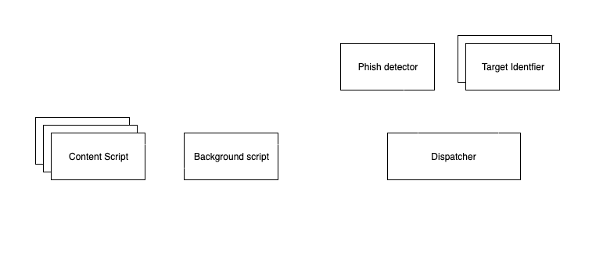
SYSTEM ARCHITECTURE

Slide 11

HIGH LEVEL
BLOCK DIAGRAM

Slide 12
BACKGROUND SCRIPT
Begin
For each page load redirect
Add listener to that event
Get the list of redirects from listener
If page is fully loaded
Send the list of redirects to content script
Done
End

Slide 13
CONTENT SCRIPT
Begin
For each page load redirect
If page is fully loaded
Get the URL from the tab
Get the HTML content from innerHTML tag
Get redirection list from background script
Send them to the background process
Done
End

Slide 14
DISPATCHER
Begin
If page address is in whitelist
Send the GREEN signal
Else
Send content to phish detector
Get results from phish detector
If phish is FALSE
Send the GREEN signal
Else
Send the RED signal
Send content to target identifier
If target is found
Publish target
Else
No target matched
End

Slide 15
PHISH DETECTOR
Begin
For each page URL
Get the feature values for the URL
Load the saved model
Publish the result
Done
End

Slide 16
TARGET IDENTIFIER
Begin
Get the hash value for page content
Compare with values in hash list
If match
Display target
Else
No target found
End

Slide 17
IMPLEMENTATION
CONTENT SCRIPT
BACKGROUND SCRIPT

Slide 18
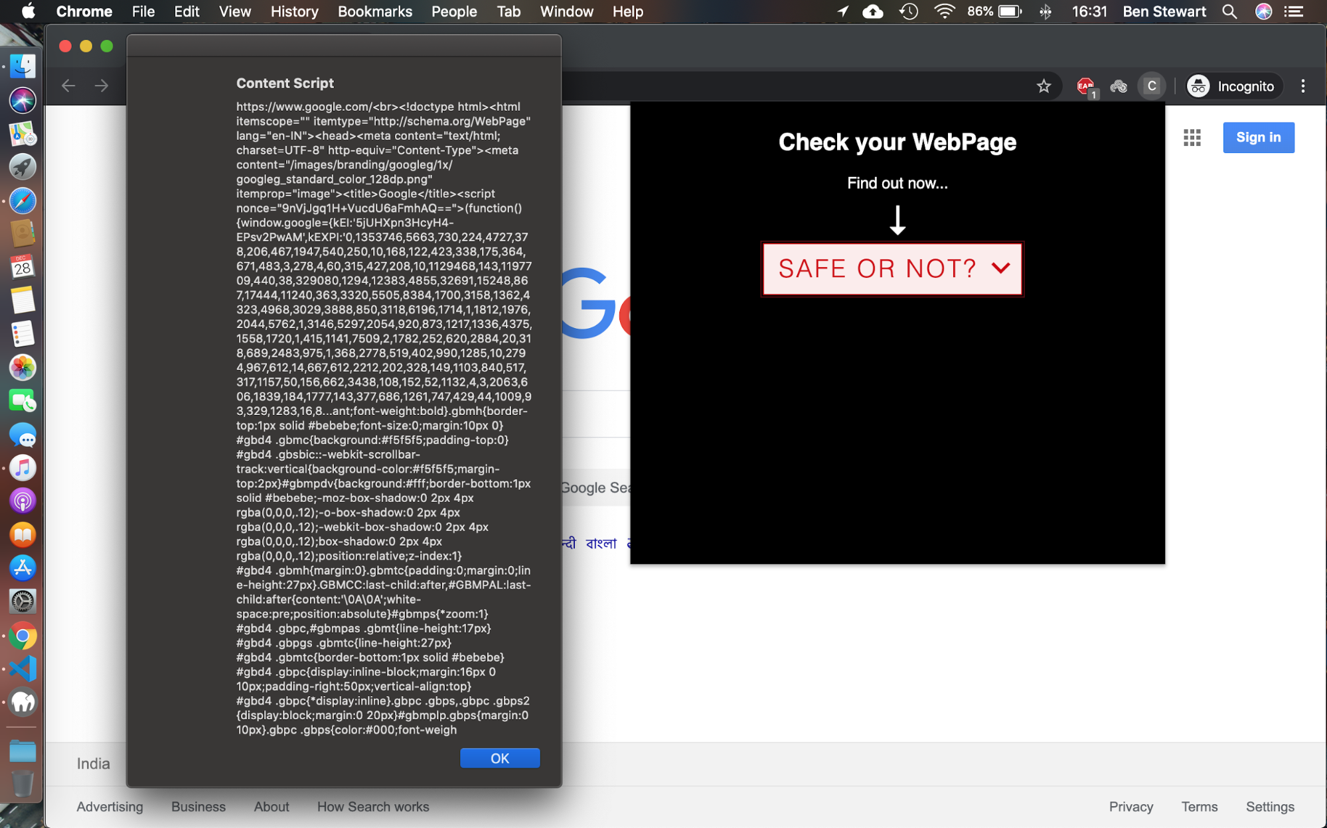
CONTENT SCRIPT

Slide 19
CONTENT SCRIPT
//Retrieve URL JS
tablink = tab.url;
//Retrieve Page content PHP
$site=$_POST['url'];
$html = file_get_contents($site);

Slide 20

BACKGROUND SCRIPT

Slide 21
BACKGROUND SCRIPT
//URL path item
url: pathItem.url,
status: pathItem.status_line,
redirect_type: pathItem.redirect_type,
redirect_url: pathItem.redirect_url,
meta_timer: pathItem.meta_timer

Slide 22
EVALUATION METRICS
Phish detection accuracy
Target detection ratio
Memory usage
Addon stability
Ease of use
Temporal resilience

Slide 23
REFERENCES
S. Marchal, G. Armano, T. Gröndahl, K. Saari, N. Singh, N. Asokan, "Off-the-hook: An efficient and usable client-side phishing prevention application", IEEE Trans. Comput., vol. 66, no. 10, pp. 1717-1733, Oct. 2017.
A. K. Jain, B. B. Gupta, "A novel approach to protect against phishing attacks at client side using auto-updated white-list", EURASIP J. Inf. Secur., vol. 2016, no. 1, Dec. 2016.
G. Xiang, J. Hong, C. P. Rosé, L. Cranor, "CANTINA: A feature-rich machine learning framework for detecting phishing Web sites", ACM Trans. Inf. Syst. Secur., vol. 14, no. 2, 2011.
Implementation for the Usage of Google Safe Browsing APIs (v4), 2019, [online] Available: https://github.com/google/safebrowsing.
C. Whittaker, B. Ryner, and M. Nazif, “Large-scale automatic classification of phishing pages,” in Proc. Netw. Distrib. Syst. Security Symp., 2010, pp. 1–14.

